Slide 1
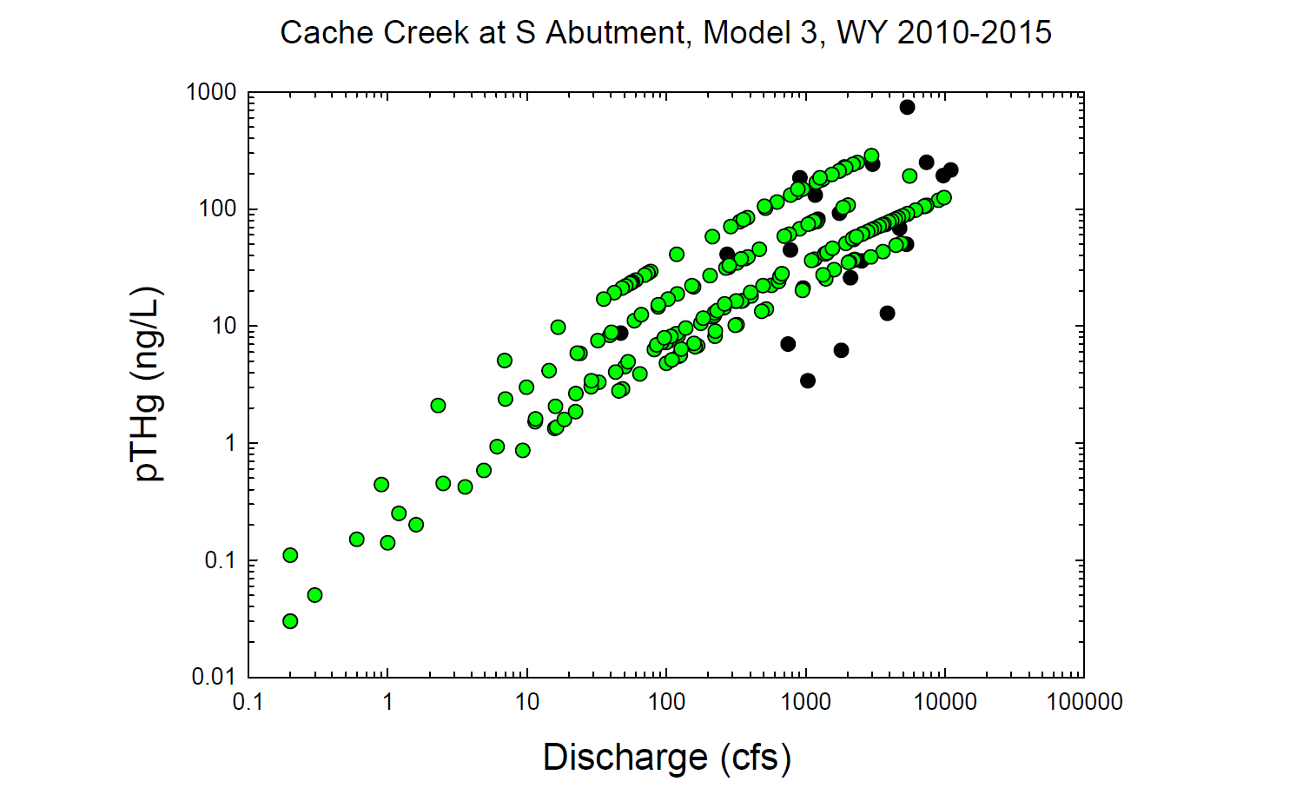
Black circles = Observed values
Green circles = Modeled values

Slide 2
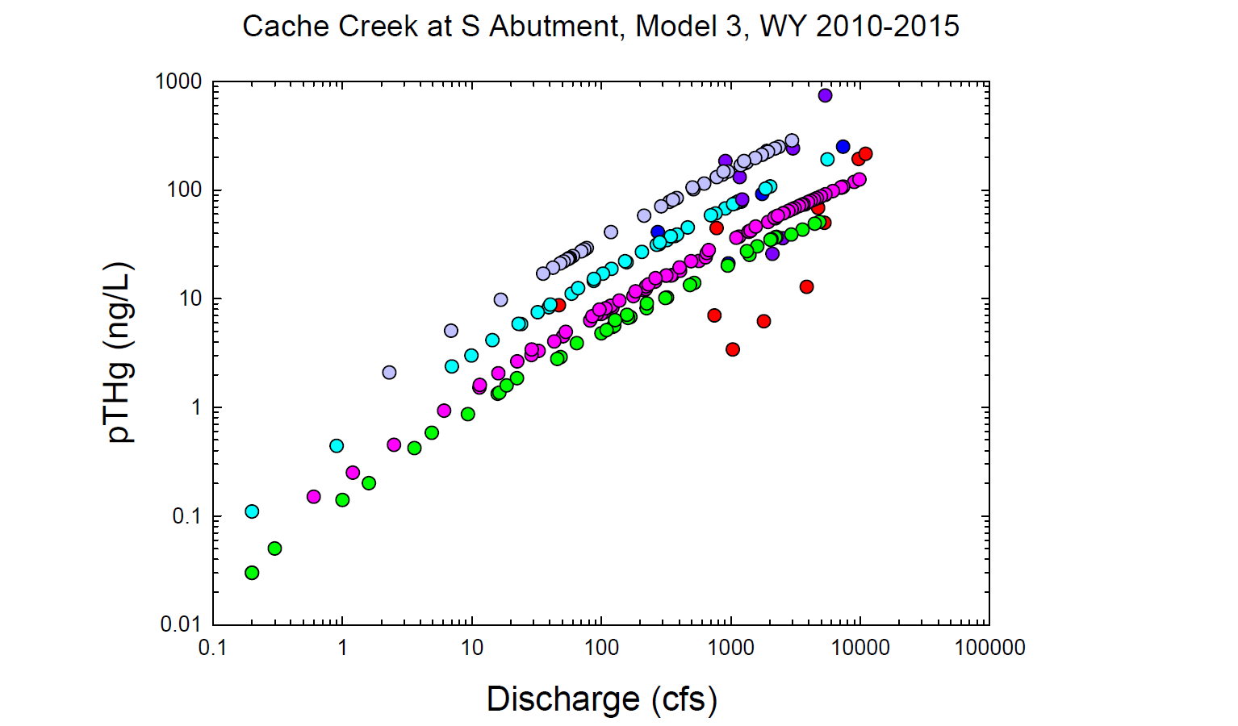
Dk. Blue = Observed wy2013
Lt. Blue = Modeled wy2013
Dk. Purple = Observed wy2015
Lt. Purple = Modeled wy2015
Green = Modeled wy2010
Red = Observed wy2011
Pink = Modeled wy2011

Slide 3
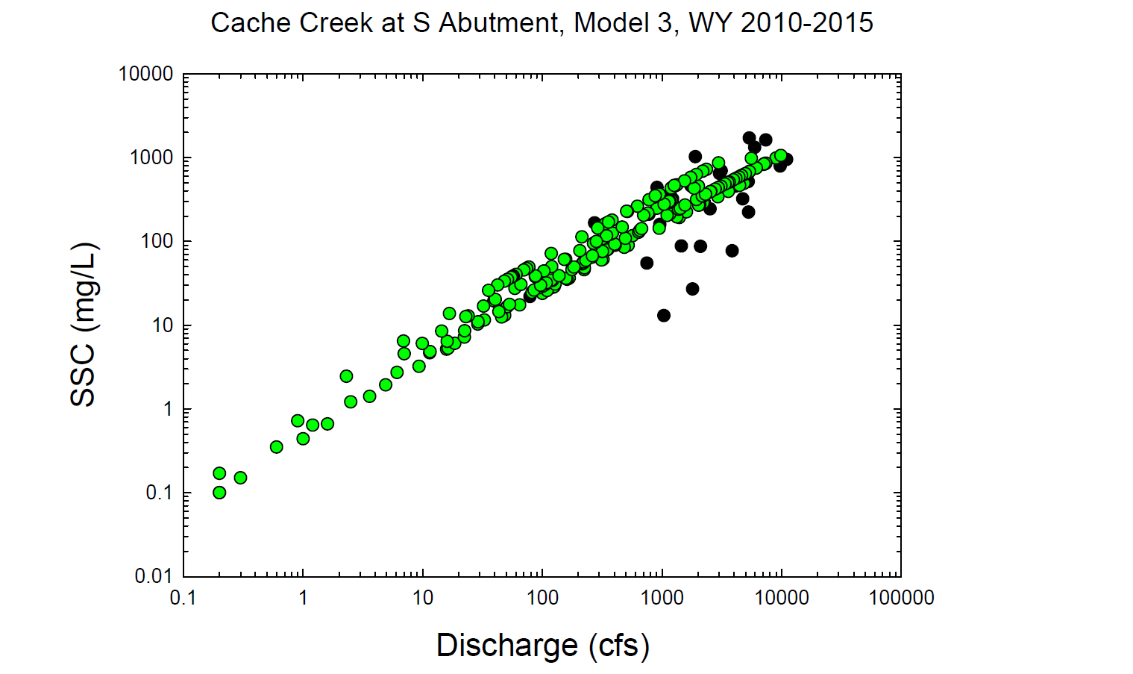
Black circles = Observed values
Green circles = Modeled values

Slide 4
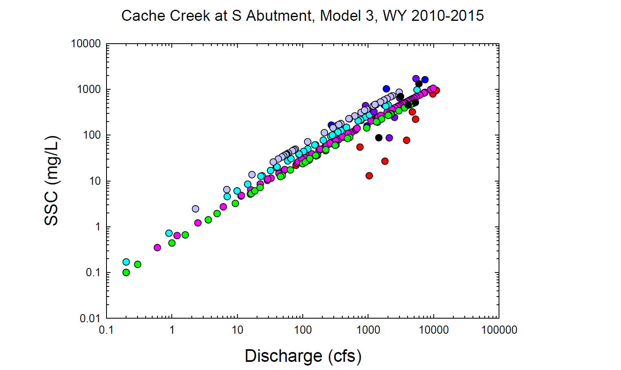
Black = Observed wy2010
Green = Modeled wy2010
Red = Observed wy2011
Pink = Modeled wy2011
Dk. Blue = Observed wy2013
Lt. Blue = Modeled wy2013
Dk. Purple = Observed wy2015
Lt. Purple = Modeled wy2015

